Slide 1
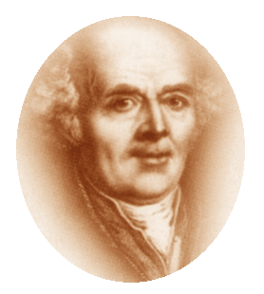
PREPARED BY DR.RAMYA S.S ASSISTANT PROFESSOR DEPT OF HOMOEOPATHIC PHARMACY
DYNAMIC POWER
AND
DYNAMIZATION

Slide 2
'DYNAMIS' OR DYNAMIC POWER
Dynamic action or power is the action of one substance on another substance without being able to recognize a sensible connection between cause and effect.
Hahnemann calls such effects dynamic, virtual, that is, such as result from absolute, specific, pure energy and action of one substance upon the other substance.

Slide 3
Earth carries the moon around in
28 days and the moon raises the
seas to high tide.
This takes place not through material agencies, not through mechanical device.

Slide 4
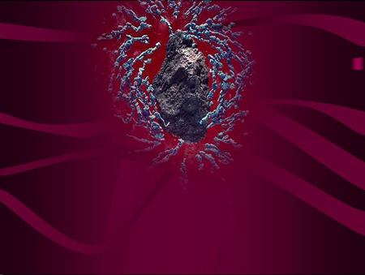
Similarly, the energy of a magnet
attracting a piece of iron or steel is not
material. One sees that the piece of iron
is attracted by one pole of the magnet,
but how it is done is not seen.
The steel needle becomes itself magnetic,
even at a distance when the magnet does not
touch it, and magnetises other steel
needles with the same magnetic property
(dynamically).

Slide 5
In the same way, the dynamic effect of the sick-making influences upon healthy man, as well as the dynamic energy of the medicines upon the principle of life in the restoration of health is not in any way material, not in any way mechanical.
The effect of medicines upon living man is to be similarly judged.

Slide 6
In 1813, Hahnemann published
'The Spirit of Homoeopathy', wherein he stated -
‘Disease was only a dynamic derangement of the vital character of the organism. Drugs, besides their physicochemical properties, possess another property by virtue of which they alter the qualitative state of the organism through its altered sensations and functions. The more the materiality of a drug is reduced, the greater the specific therapeutic quality lying hitherto dormant in the drug seemed to be liberated.’
This is the seed of dynamization theory.

Slide 7
Homoeopathic Dynamizations
are processes by which the medicinal
properties that are latent in natural
substances while in their crude state,
become aroused, and then become enabled to act in an almost spiritual manner on our life, i.e. on our sensible and irritable fibre.

Slide 8
According to Stuart Close,
"Homoeopathic potentiation is a mathematico-mechanical process for the reduction, according to scale, of crude, inert or poisonous medical substances to a state of physical solubility, physiological assimilability and therapeutic activity and harmlessness, for use as homoeopathic healing remedies".

Slide 9
DILUTIONS AND POTENCIES (DYNAMIZATIONS)
A solution of salty or bitter substances
becomes continually more deprived of
its taste the more water is added, and
eventually has hardly any taste, no
matter how much it may be shaken.

Slide 10
So, also, a solution of coloring matter,
by admixture of more and more water, becomes at last almost colorless,
and any amount of shaking will not increase its color.
Dilutions exist almost solely in objects
of taste and of color. These are and continue to be mere dilutions, not Dynamizations.

Slide 11
ADVANTAGES OF POTENTIZATION
To avoid unnecessary medicinal aggravation and side effects by a continued process of reducing the material quantity of a drug.
Medicinal properties that are latent in crude state, become aroused and awakened into activity.

Slide 12
Substances that are poisonous or toxic
in their crude state become important
beneficial remedies after potentization,
like corrosive acids, poisons, heavy
metals, venoms, etc.
Substances that are medicinally inert in
their crude state may be rendered active
after potentization.

Slide 13
The concept of life, health and disease is not material, but dynamic in nature. Hence the concept of cure is also dynamic – and these properties are revealed by potentization and provings.
Potentization helps reveal peculiar 'individualistic' properties of a drug aiding in selection of the similimum on the basis of similarity of these peculiar individualistic symptoms.

